Slide 1
1. Introduction
Introduction
  Fundamentals and Terms
  Basic Measurements
  Technologies
      Satellite positioning
      Mobile positioning
      Short-range location techniques
  Applications
Location technologies / OAMK / RR
11.3.2014

Slide 2
Introduction
Where do we need location technologies?
Discuss in small groups:
  Give three examples of services or equipment that are using positioning
Location technologies / OAMK / RR
11.3.2014

Slide 3
Introduction
The basic task of a wireless communication system?
  Information transfer
  Nowadays also location information is often needed
    Personal safety
    Industrial monitoring and control
    Asset tracking
    Commercial purposes etc.
The "killer application” in the positioning is predicted to be not the positioning data itself, but the possibility to use and offer services, that can utilize positioning data
Location technologies / OAMK / RR
11.3.2014
Notes:
The basic task of a wireless communication system is to transfer information from one terminal to one or more other terminals.
By using characteristiscs of the transmitted signal itself => estimating how far one terminal is from another or where that terminal is located

Slide 4
Clustering of positioning topics
High end service
navigation=position+speed
other
technologies
Satellite systems
Mobile Networks
Positioning
(location)
RF methods Proximity method Fingerprint method
RSS Received signal strength
TOF Time of flight
AOA, DOA Angle or direction of arrival
Location technologies / OAMK / RR
11.3.2014
"Location only"

Slide 5
1.1. Fundamentals and Terms
Distance measuring
  To determine the radius of a circle or of a sphere
  May be used to compute locations
Location (”where is it?”)
  Point in space which is described as a symbolic place (e.g. a room or street) or as a set of coordinates defined as distances or angles in relation to another point
Position generally synonymous with location
Positioning
  Process of finding the two or three-dimensional coordinates of a terminal
Location technologies / OAMK / RR
11.3.2014

Slide 6
1.1. Fundamentals and Terms (cont.)
Range
  The greatest distance between two terminals over which communication is supported
  May be used also as any distance between terminals that has been calculated by distance measurement or location techniques
Global versus local positioning?
  Global positioning system is able to give general purpose coordinates (reference to general maps)
  Local positioning system is able to locate a thing (person, equipment…) in its own, limited environment, e.g. a house, factory and so on
Location technologies / OAMK / RR
11.3.2014
Notes:
Bearing = suuntimatieto
Beacon = majakka, suuntalähetin

Slide 7
1.1. Fundamentals and Terms (cont.)
A beacon
  A continuous or periodic transmission that facilitates timing synchronization or position measurements between terminals
Navigation
  The determination of the position and velocity of a moving vehicle
Accuracy
  Refers to how much the estimated position is deviated from the true position
Precision
  An indication of the repeatability of a measurement
Resolution
  The smallest readout intervals
Location technologies / OAMK / RR
11.3.2014
Notes:
Bearing = suuntimatieto
Beacon = majakka, suuntalähetin
The key metric for evaluating a localization technique is the accuracy defined as, how much is the estimated position deviated from the true position. Its not just enough if the accuracy is obtained just once, it should also be consistent from measurement to measurement. For achieving high accuracy ultrasound and UWB technologies for indoor location sensing would be of good choice. The accuracy is denoted by an accuracy value and precision value (e.g. 15 cm accuracy over 95% of the time). The precision indicates how often we expect to get at least the given accuracy. The accuracy of a location sensing systems is often used to determine whether the chosen system is applicable for certain applications.

Slide 8
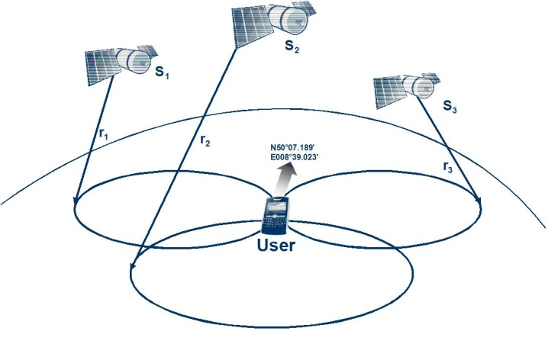
1.1. Fundamentals and Terms (cont.)
Unilateral locationing:
  The target receives transmissions from multiple terminals, whose positions are known, and calculates its own position.
  E.g. GPS
Multilateral locationing:
  The target is a transmitter whose location is calculated from measurements taken by multiple fixed terminal receivers whose positions are known.
  E.g. cellular positioning
Location technologies / OAMK / RR
11.3.2014
Notes:
Bearing = suuntimatieto
Triangulation can be used to find the coordinates and sometimes distance from e.g. the shore to the ship. The observer at A measures the angle α between the shore and the ship, and the observer at B does likewise for β . If the length l or the coordinates of A and B are known, then the law of sines can be applied to find the coordinates of the ship at C and the distance d. http://en.wikipedia.org/wiki/Triangulation

Slide 9
1.2. Basic Measurements
There are three basic properties that enable distance measurement and location from analysis of specific physical characteristics of radio signals:
    Received signal strength (RSS)
    Time of flight (TOF)
    Angle of arrival (AOA) or direction of arrival (DOA)
All methods of distance measurement and location are derived from the measurements above, alone or in combinations. There are two variants of these methods that differ enough from the normal cases:
    Proximity
    Fingerprinting
These basic measurements are studied further next week!
Location technologies / OAMK / RR
11.3.2014

Slide 10
1.3. Technologies
There are three basic categories for location technologies:
    Satellite positioning (GPS, Galileo, Glonass, pseudolites, etc.)
    Cellular handset locationing (GSM/UMTS, LTE)
    Short-range location techniques (UWB, RFID, WLAN, Bluetooth, ZigBee, Ultrasound, etc.)
Location technologies / OAMK / RR
11.3.2014

Slide 11
1.3. Technologies (cont.)
Performance parametric measures of location identification:
  Accuracy
  Calibration
  Responsiveness
  Scalability
  Cost
  Power consumption
  Privacy
Location technologies / OAMK / RR
11.3.2014
Notes:
Calibration: The uncalibrated ranging readings are always greater than the true distance and are highly erroneous due to transmit and receive delays. Device calibration is the process of forcing a device to conform to a given input/output mapping. This is often done by adjusting the device internally but can equivalently be done by passing the devices output through a calibration function that maps the actual device response to the desired response.
Responsiveness is defined as how quickly the location system outputs the location information. It is an important parameter, especially when dealing with mobility. However, this parameter is mostly ignored in the description of the existing systems.
Responsiveness is defined as how quickly the location system outputs the location information. It is an important parameter, especially when dealing with mobility. However, this parameter is mostly ignored in the description of the existing systems.
Cost, which includes the cost of installation, deployment, infrastructure and maintenance. An important cost factor when running the system in a real environment is power consumption. When scaling to thousands or millions of autonomous small devices it is clearly not feasible to change or recharge batteries very often, thus energy efficiency should be a goal of any localization mechanism meant for a large scale system. For example in the area of wireless sensor network the goal is to provide energy autonomy to the nodes beyond three years of operation.
In our view privacy is an important parameter of localization systems and it should form part of the architecture since its conception. Using localization it is very easy to create a Big Brother infrastructure that track users movements and allow to deduce patterns of behavior. However, this issue is being generally overlooked in the design of systems and considered as an after thought only. Centralized systems are particularly weak with regard to privacy.

Slide 12
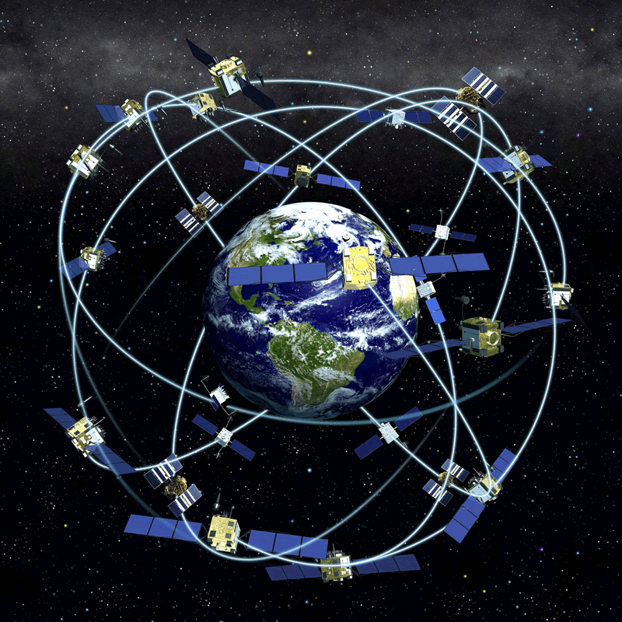
1.3. Technologies (cont.)
Satellite positioning (GPS, Galileo, Glonass, pseudolites, etc.)
  GPS (the Global Positioning System) is a network of 24 Navstar satellites orbiting Earth at around 20 000 km
    Originally established by the U.S. Department of Defence (DOD) at a cost of about US$13 billion,
    Access to GPS is free to all users, including those in other countries.
Location technologies / OAMK / RR
11.3.2014
Notes:
http://www.palowireless.com/gps/tutorial.asp

Slide 13
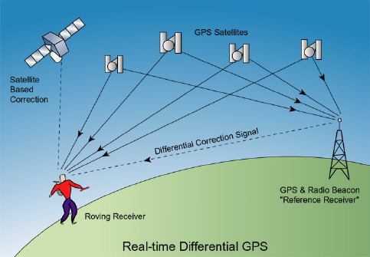
1.3. Technologies (cont.)
    The system’s positioning and timing data are used for a variety of applications, including air, land and sea navigation, vehicle and vessel tracking, surveying and mapping, and asset and natural resource management.
    With military accuracy restrictions partially lifted in March 1996 and fully lifted in May 2000
    The DOD keeps 4 satellites in reserve to replace any destroyed or defective satellites. The satellites are positioned so that signals from six of them can be received nearly 100 percent of the time at any point on earth.
Location technologies / OAMK / RR
11.3.2014

Slide 14
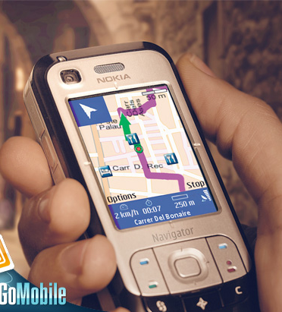
1.3. Technologies (cont.)
    GPS provides specially coded satellite signals that can be processed in a GPS receiver, enabling the receiver to compute position, velocity and time.
    Basically GPS works by using four GPS satellite signals to compute positions in three dimensions (and the time offset) in the receiver clock. So by very accurately measuring our distance from these satellites a user can triangulate their position anywhere on earth.
Location technologies / OAMK / RR
11.3.2014

Slide 15
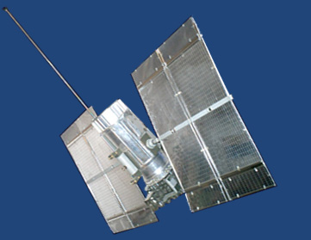
1.3. Technologies (cont.)
  GLONASS
    GLONASS is the Russian satellite navigation system. The system was declared fully operational on 18 January 1996 but by late 1997 only 15 satellites were available for navigation due to quality issues and funding problems.
    Altogether, there should be 24 satellites in three orbital planes. Initially, system completion was planned by the year 2012, but with close attention from the Russian government, the system was deployed in full scale by the end of 2009.
    Accuracy of few tens of metres
Location technologies / OAMK / RR
11.3.2014
Notes:
http://www.palowireless.com/gps/tutorial.asp

Slide 16
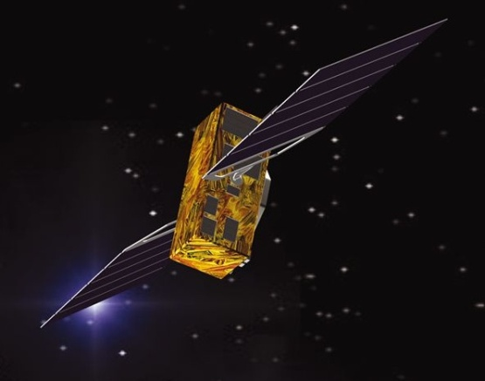
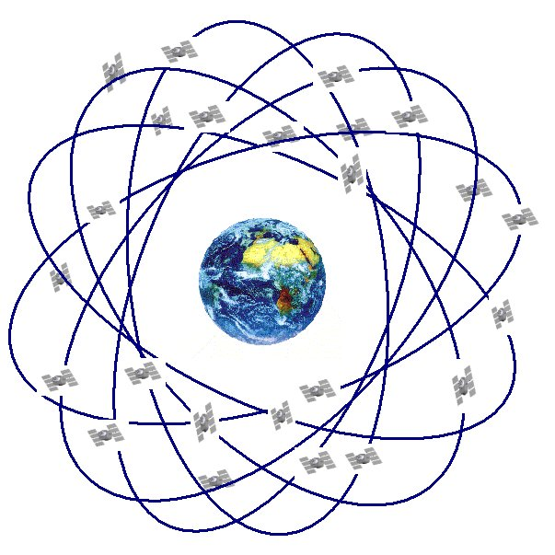
1.3. Technologies (cont.)
  Galileo
    A global navigation satellite system currently being built by the European Union (EU) and European Space Agency (ESA).
    On 30 Nov 2007 the 27 EU transportation ministers involved reached an agreement that it should be operational by 2013
    Should be accurate down to the metre range including the height (altitude) above sea level
    30 satellites, orbital altitude 23 222 km
Location technologies / OAMK / RR
11.3.2014
Notes:
http://www.palowireless.com/gps/tutorial.asp

Slide 17
1.3. Technologies (cont.)
Cellular handset location (GSM/UMTS)
  There are various means of mobile positioning, which can be divided into two major categories - network based and handset based positioning. The purpose of positioning the mobile is to provide location-based services (LBS), including wireless emergency services.
  Location service: A service that is producing the location information
  Location-based service: A value-added service which is utilizing location information
  Location-aware service: A service that is based on location service and which is modifying its functioning or content according to users location
Location technologies / OAMK / RR
11.3.2014

Slide 18
1.3. Technologies (cont.)
  Requirements for Mobile Location Methods
    Good accuracy
    Positioning area should be global
    Short positioning time
    As small amount of signalling in the network as possible
    In mobile station: power, size and price should be minimised
    Consumer should be able to keep his privacy and disable the service
    Ability to locate a large number of mobiles at the same time
    Ability to locate all mobile devices
    Conclusion: There is no single method that is suitable for all applications. Several location methods have been developed for different purposes.
Location technologies / OAMK / RR
11.3.2014

Slide 19
1.3. Technologies (cont.)
  Methods used in mobile positioning:
    Cell-ID
    TA: Timing advance
    RSS: Received signal levels
    RTT: Round trip time
    AOA: Angle of arrival
    TOA: Time of arrival
    TDOA: Time difference of arrival
    E-OTD: Enhanced observed time difference
    OTDOA: Observed time difference of arrival
    A-GPS: Assisted GPS
Location technologies / OAMK / RR
11.3.2014

Slide 20
1.3. Technologies (cont.)
  Accuracy of different mobile positioning methods
Rural
Urban
GPS
AGPS
DGPS
Cell ID (+TA or RSS)
TOA, TDOA, OTDOA
and EOTD
Heavy urban
Indoor
Accuracy/km
0,001
0,01
0,1
1
10
100
Location technologies / OAMK / RR
11.3.2014

Slide 21
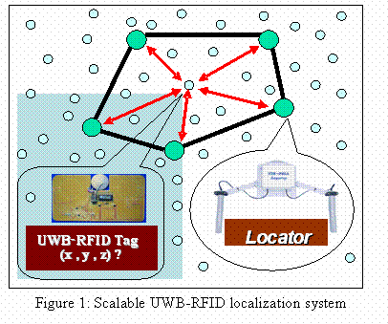
1.3. Technologies (cont.)
Short-range location techniques (UWB, RFID, WLAN, Bluetooth, ZigBee, Ultrasound, etc.)
  Typical characteristics
    Low power and small terminals
    Short distances (typically <100 m)
    Short TOF => time resolution needed around 10 ns (equivalent of 3 m range)
    Indoor environment (NLOS, severe multipath conditions)
    Usage of unlicenced bands => interference from other system signal types
Location technologies / OAMK / RR
11.3.2014

Slide 22
1.3. Technologies (cont.)
  The position methods mostly used for the short-range wireless networks are TOA, RSS and fingerprinting
    Proximity detection is also used but can be considered as form of RSS
    Multipath propagation may cause large deviations of the estimates from the true values
    Fingerprinting requires the creation of a database that is individual for each site to be covered (changes require updating the database)
    Movement of people at the site may affect accuracy
Location technologies / OAMK / RR
11.3.2014

Slide 23
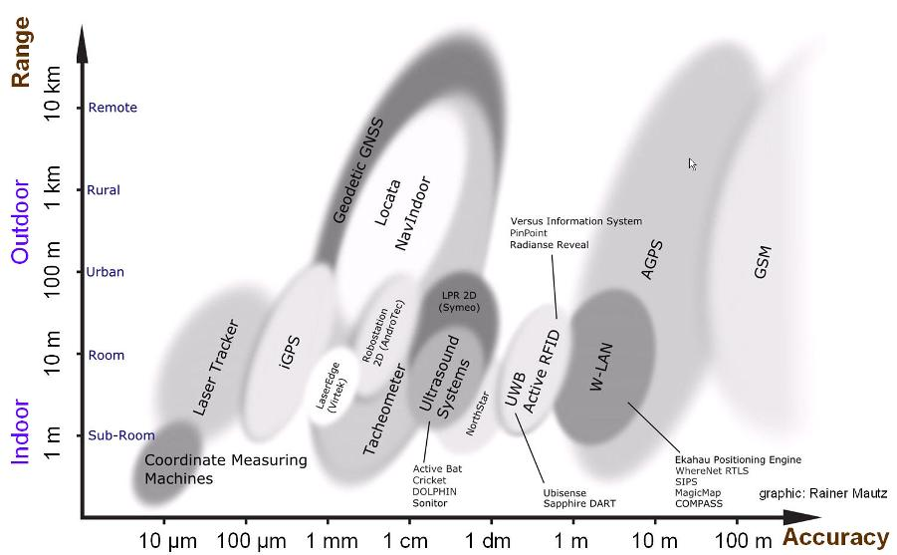
1.3. Technologies (cont.)
Location technologies / OAMK / RR
11.3.2014

Slide 24
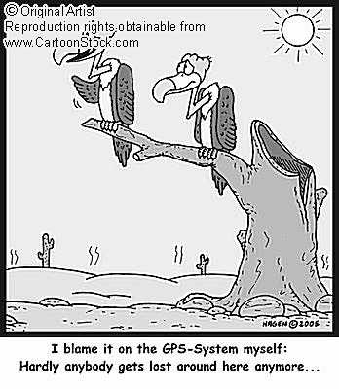
1.4. Applications
    http://www.youtube.com/watch?v=qZlc_x6amaQ (Search and locate part 1)
    Governmental
    Safety and security
    Operator-based
    Traffic and logistics
    Entertainment and socializing
    Miscellaneous
Location technologies / OAMK / RR
11.3.2014

Slide 25
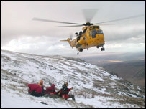
1.4. Applications (cont.)
  Governmental
    US FCC ruled in 1996, that in wireless networks the location accuracy for emergency calls must be (in the end of year 2005)
      50 m for 67% of calls, 150m for 95% of calls for handset-based solutions
      100 m for 67% of calls, 300m for 95% of calls for network-based solutions
    Also in Europe location services are used for different purposes in emergency services
    Military applications:
      Military intelligence
      Force tracking
    Surveillance of citizens
Location technologies / OAMK / RR
11.3.2014

Slide 26
1.4. Applications (cont.)
  Safety and security
    Criminal tracking: tracking people that are on parole or on vacation from prison
    Crime and terrorist attack prevention. Also lawful interception can be combined to positioning
    Asset tracking: following money or important papers which are transported
    Family monitoring: keeping an eye on children or elderly family members
Location technologies / OAMK / RR
11.3.2014

Slide 27
1.4. Applications (cont.)
  Operator-based (mobile phone locationing)
    Location-specific billing: e.g. cheaper calls at home or office than out in the city
    Network planning purposes
    Parameter settings, e.g. handover thresholds and network demand monitoring
    Network maintenance
    Enhanced call routing
Location technologies / OAMK / RR
11.3.2014

Slide 28
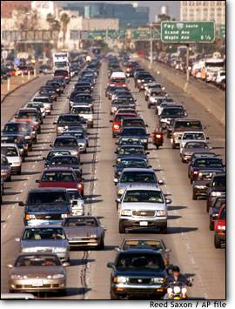
1.4. Applications (cont.)
  Traffic and logistics
    Traffic information; Traffic jams, accidents, roadworks etc.
    Tracking of stolen cars
    Fleet management: trucks, taxis, ships etc.
    Manpower planning: positioning the nearest service man
    Car navigation: route planning and map services for moving vehicles
Location technologies / OAMK / RR
11.3.2014

Slide 29
1.4. Applications (cont.)
    Maritime applications: security and logistics
    Public transportation: real-time controlling of the functioning of buses, trains and local timetable information
    Vehicle tracking for security and logistics purposes. For example work orders and instructions may be given according to accurate location of the vehicle or the employee
    Road information: access to digital road data system based on actual location
    Towing service for broken cars or the nearest garage
Location technologies / OAMK / RR
11.3.2014

Slide 30
1.4. Applications (cont.)
  Entertainment and socializing
    Social applications
    Find-a-friend services, dating services
    Location-based network games, e.g. geocaching
    Useful tourist information, e.g. restaurants, theatres and other leisure time activities based on Your own location
    Shopping information and discounts based on your location
Location technologies / OAMK / RR
11.3.2014

Slide 31
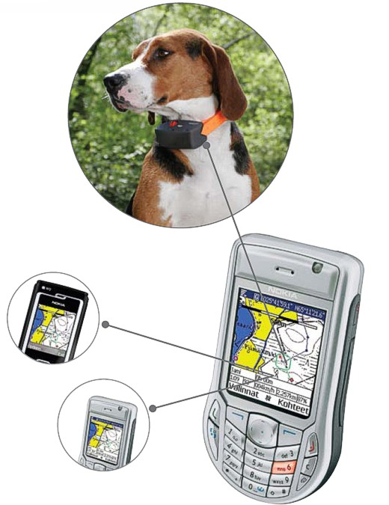
1.4. Applications (cont.)
  Miscellaneous applications
    Dog radar
    Advertisements, special offers,…
    Location-based Yellow Pages
Location technologies / OAMK / RR
11.3.2014

